Slide 1

Rivian Automotive Inc. Financial Data Analysis
By: Khoi Duong

Slide 2

Rivian Automotive Inc.
Founded in 2009
Electric SUVs & pickup truck manufacturer/seller
Plans to develop network of public charging stations

Slide 3




Why Analyze Rivian?
Tesla’s Historical Stock Performance
Funded By Amazon & Ford
High Long-Term Profitability Potential

Slide 4


Research Questions
What do Rivian’s liquidity ratios suggest about the company’s ability to repay short-term and long-term obligations?
How do Rivian’s leverage financial ratios help evaluate the company’s debt levels?
How do Rivian’s efficiency ratios help measure how well the company utilizes its assets and resources?
Are Rivian’s profitability ratios having a growth rate?
Do Rivian’s market value ratios show favorable trends?

Slide 5

Financial Modeling Prep (API)
Rivian’s Balance Sheet (2019-2022)
Rivian’s Income Statements (2019-2022)
Rivian’s Statement of Cash Flows (2019-2022)

Slide 6
Liquidity Ratios

Slide 7
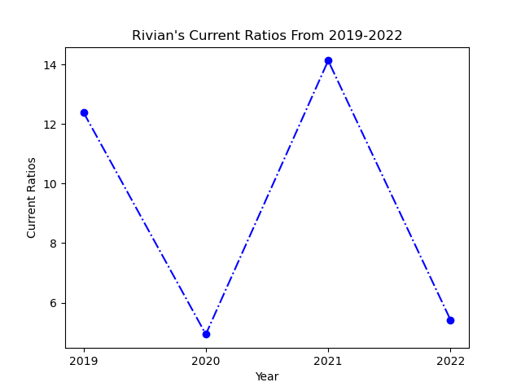
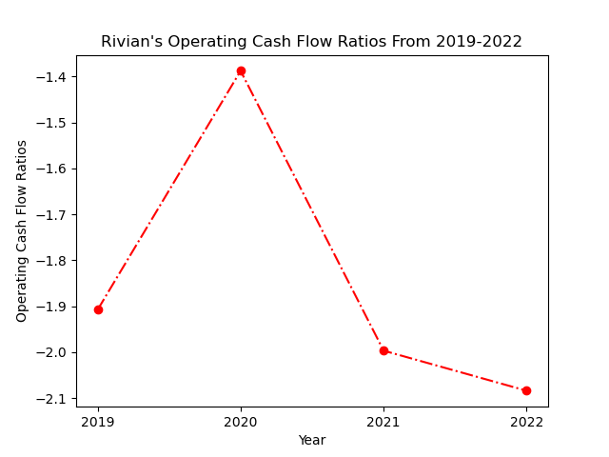
Liquidity Ratios
Current Ratio:
Current Assets / Current Liabilities
Operating Cash Flow Ratio:
Net Operating Cash Flow / Current Liabilities

Slide 8
Leverage Financial Ratios

Slide 9
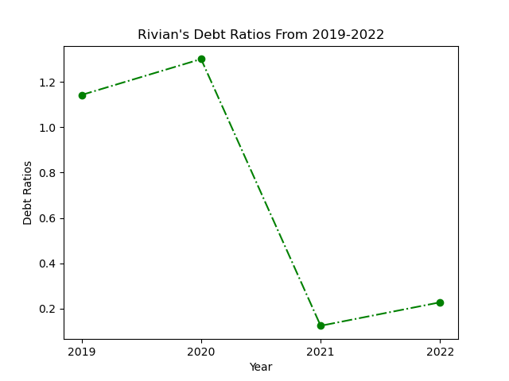
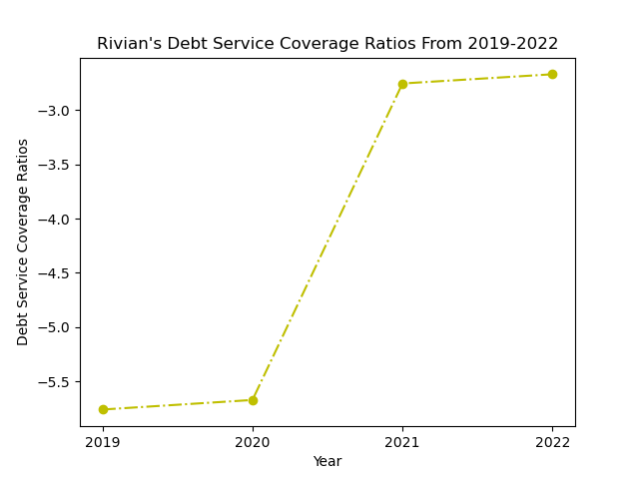
Leverage Financial Ratios
Debt Ratio:
Total Liabilities / Total Assets
Debt Service Coverage Ratio:
Operating Income / Total Debt

Slide 10
Efficiency Ratios

Slide 11
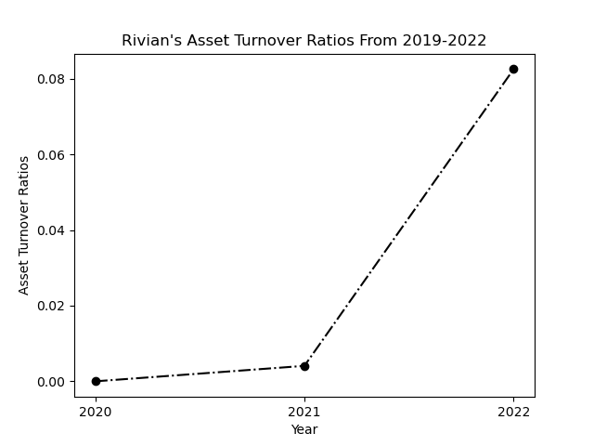
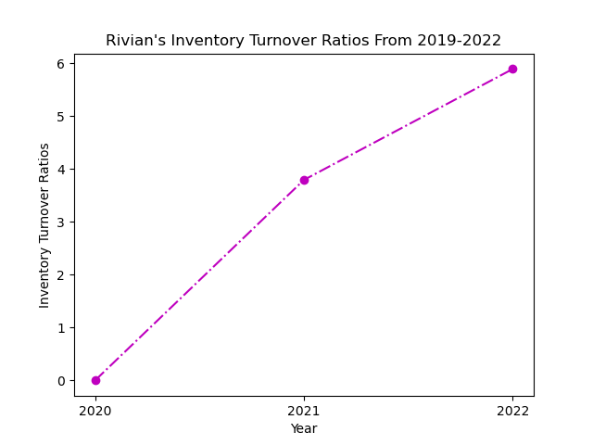
Efficiency Ratios
Asset Turnover Ratio:
Revenue / Average Total Assets
Inventory Turnover Ratio:
Cost Of Goods Sold / Average Inventory

Slide 12
Profitability Ratios

Slide 13
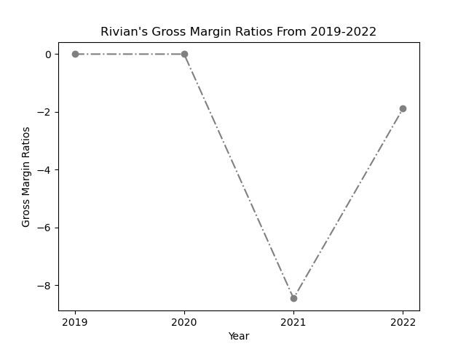
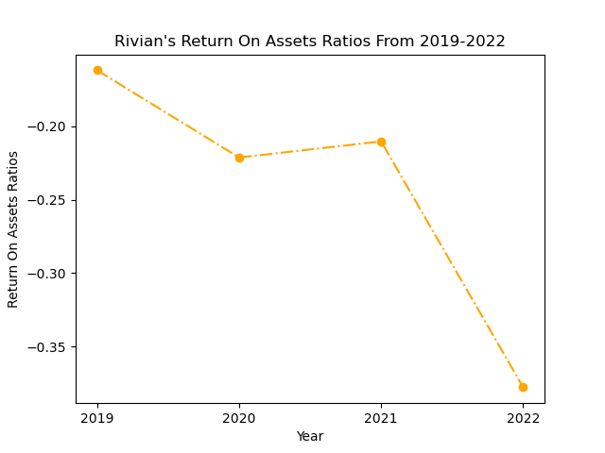
Profitability Ratios
Gross Margin Ratio:
Gross Profit / Revenue
Return On Assets Ratio:
Net Income / Total Assets

Slide 14
Market Value Ratios

Slide 15
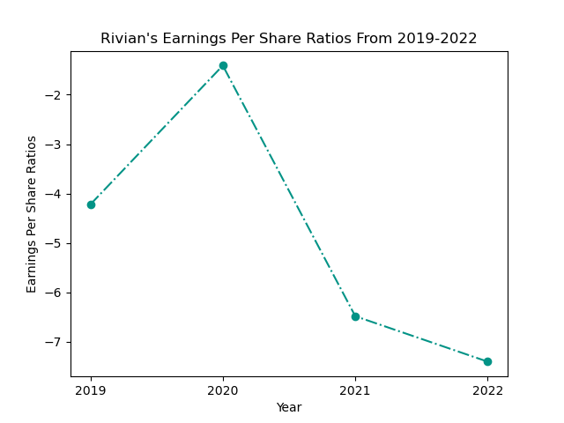
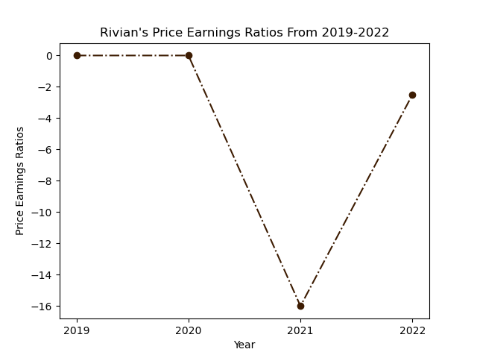
Market Value Ratios
Earnings Per Share Ratio:
Net Income / Total Shares Outstanding
Price-Earnings Ratio:
Share Price / Earnings Per Share

Slide 16
Findings Implications

